Slide 1
CNN for 3D shape analysis
SY1706132 陈志远

Slide 2
CNN is Awesome in 2D image analysis
LeNet
AlexNet
GoogleNet
VGG
ResNet
SENet

Slide 3
How about apply CNN in 3D space
Problem: Data Structure(Mesh?Voxel? Point Cloud? Or sth else?)
Limitation: Meomery (3D model is big)
Time（also because 3D model is big）

Slide 4
Voxel-based Method
D. Maturana and S. Scherer. 2015. VoxNet: a 3D convolutional neural network for real-time object recognition. In International Conference on Intelligent Robots and Systems (IROS)
Full 3D Conv. On the Voxel Matrix.

Slide 5
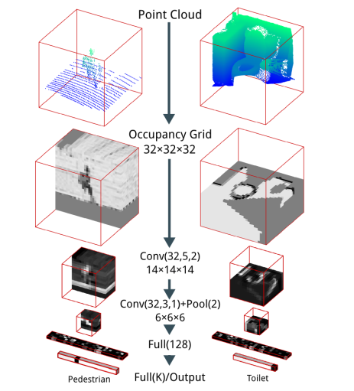
Voxel-based Method（It’s Rough）

Slide 6
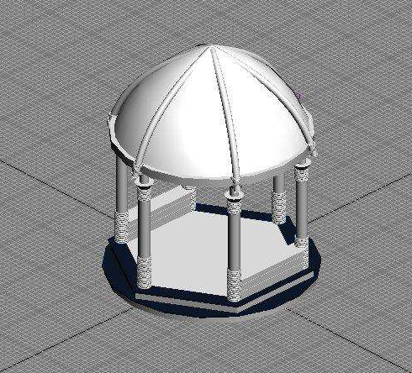
Problem: Information stores in Surface

Slide 7
Manifold
D. Boscaini, J. Masci, S. Melzi, M. M. Bronstein, U. Castellani, and P. Vandergheynst.2015. Learning class-specifc descriptors for deformable shapes using localizedspectral convolutional networks. Comput. Graph. Forum 34, 5 (2015), 13–23.
M. M. Bronstein, J. Bruna, Y. LeCun, A. Szlam, and P. Vandergheynst. 2017. Geometric deep learning: going beyond Euclidean data. IEEE Sig. Proc. Magazine (2017).

Slide 8
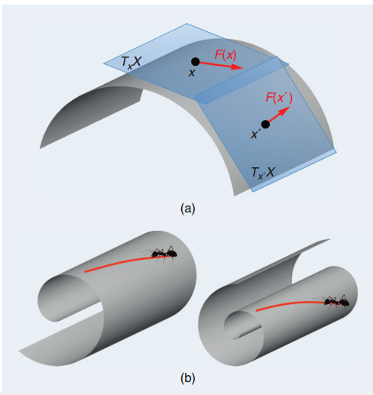
Monifold

Slide 9
Monifold
parameterize the 3D surfaces to regularly sampled feature images
2D patches
geometry images
Use 2D CNN to analyze it.
PROBLEM?

Slide 10
Monifold Problems
Require smooth manifold meshes
If the model is complex, not suitable ☹

Slide 11
Multiview-based method
Charles Ruizhongtai Qi, Hao Su, Matthias Nießner, Angela Dai, Mengyuan Yan, and Leonidas J. Guibas. 2016. Volumetric and multi-view CNNs for object classification on 3D data. In Computer Vision and Pattern Recognition (CVPR)

Slide 12
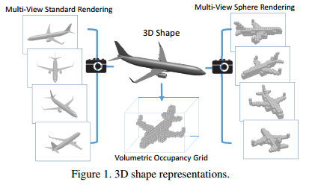
Multiview-based method

Slide 13
Multiview-based method Problem
Views Selection. (Numbers, Locations)
self-occlusion & full-cover

Slide 14
Octree-based Method
Gernot Riegler, Ali Osman Ulusoy, and Andreas Geiger. 2017. OctNet: Learning deep 3D representations at high resolutions. In Computer Vision and Pattern Recognition(CVPR).
Wang P S, Liu Y, Guo Y X, et al. O-CNN: octree-based convolutional neural networks for 3D shape analysis[J]. Acm Transactions on Graphics, 2017, 36(4):72..

Slide 15
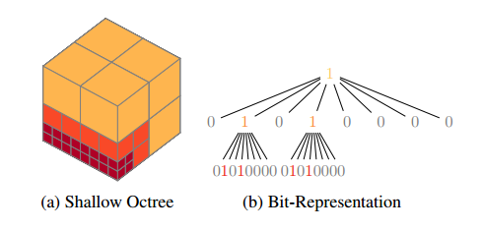
Octree

Slide 16

OctNet methods
Tree depth: 6
Max memory: 64^3 (far smaller than it) Only surface survive
Data Store: Dynamic. Not suitable for GPU ☹

Slide 17
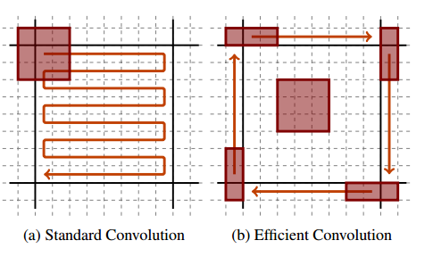
Convolution

Slide 18
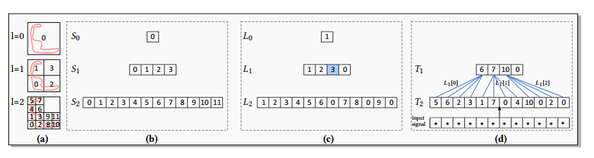
O-CNN
No-Limitation On Tree Depth.
Data Store: Linear

Slide 19
O-CNN advantages
Store Data
Efficient Computation
Information Spread

Slide 20
Experiment
Environment:

